Slide 1

Intracranial Hemorrhage Detection
Presented by Haotian Guan and Hongxu Hao

Slide 2
Introduction
Intracranial hemorrhage is a bleeding that occurs inside the cranium, is a serious health problem.
We will develop solutions to help the medical community identify the presence using RSNA dataset.

Slide 3
Data Source
RSNA Kaggle Competition
674258 CT images belonging to 17079 patients（really large!）
Image size 512*512

Slide 4
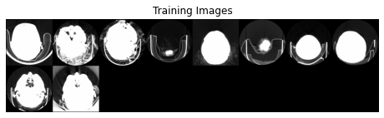
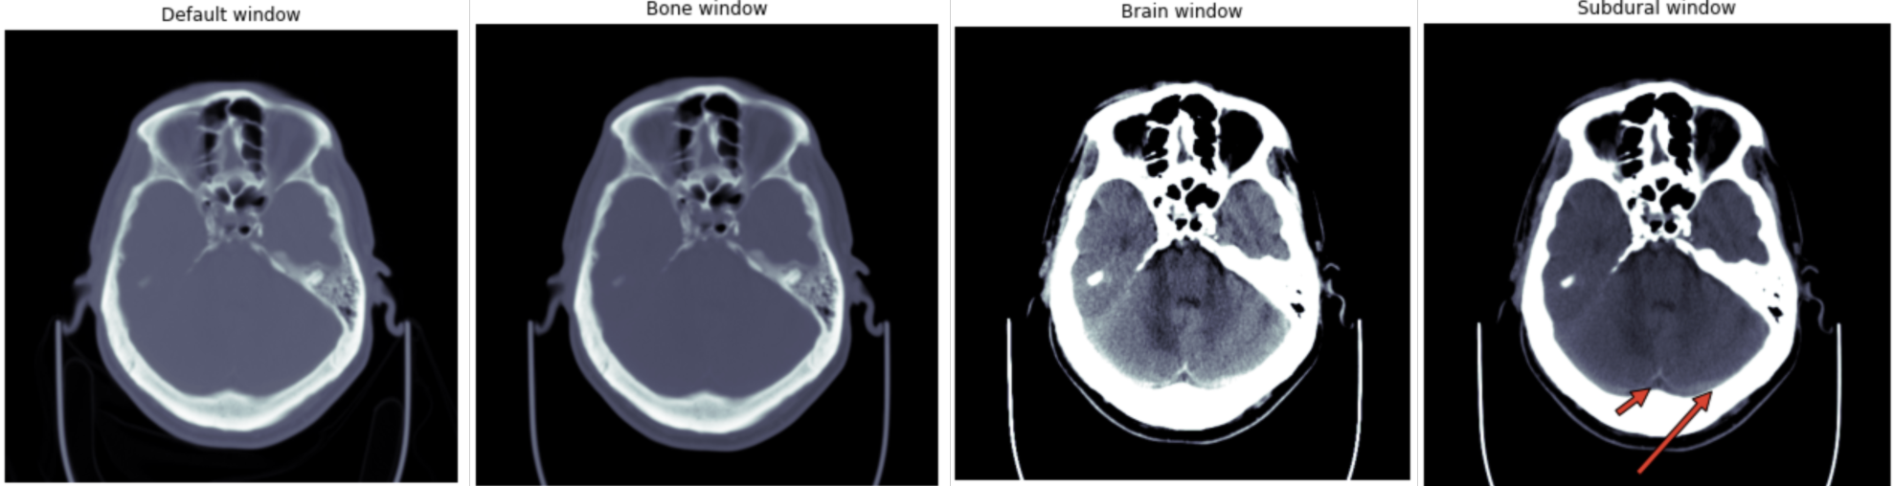
Early Data Analysis
For dcm format picture, we need to extract its information and visualize it using window functions. Otherwise, the picture will be blur.

Slide 5
Data Preprocessing
Removed 270 images with irregular shape(0.0003% of the total images)
Divided 17079 patients into 3 folds and used 1 folds
Split 5450 patients into 84% training, 8% validation, and 8% test set
Downsampled training set to have 60% Zero and 40% One
Obtained 70% training, 15% validation, 15% test

Slide 6
SRGAN
Pros: Super Resolution GAN make image more clearly, contribute to detection task(theoretically)
Cons:
1.SRGAN is really difficult to train (Generator and Discrimator together )
2. Do not have a good performance for
CT images as we thought(test it later)

Slide 7


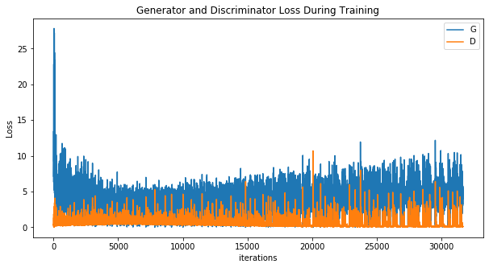
You can see gradient vanishing on the below picture. (Could not learn much things)

Slide 8
Model Overview
Baseline Model: VGG16(HH)
Architecture 1: Resnet18(HG)
Architecture 2: DenseNet(HG)
Architecture 3: EfficientNet(HH)
Improvement:
Applying window functions when loading data
hyper-parameter tuning

Slide 9

Brief Comparison Of Three Architectures:
ResNet18: Using identity mapping to ensure gradient and information flow. It allows the network to go deeper. Resnet 18 and Resnet 50 don’t have huge difference in terms of performance.
DenseNet: Applying channel-wise concatenation, which allows information and gradient flow. Having less parameters comparing to equivalent CNNs. More diversified features
EfficientNet: Fast and more accuracy theoretically, has smaller size and less parameters than other architecture. However, it is difficult for hyperparameter tuning, especially for EfficientNet B7. Not good for CT.

Slide 10
Results
Test set
 | Accuracy | AUC
ResNet18 | 0.8106 | 0.7534
EfficientNet | 0.8368 | 0.7816
DenseNet169 | 0.8289 | 0.7736
w/o window function
Test set
 | Accuracy | AUC
ResNet18 | 0.9088 | 0.9258
EfficientNet | 0.9103 | 0.9176
DenseNet169 | 0.9185 | 0.9331
w/ window function

Slide 11
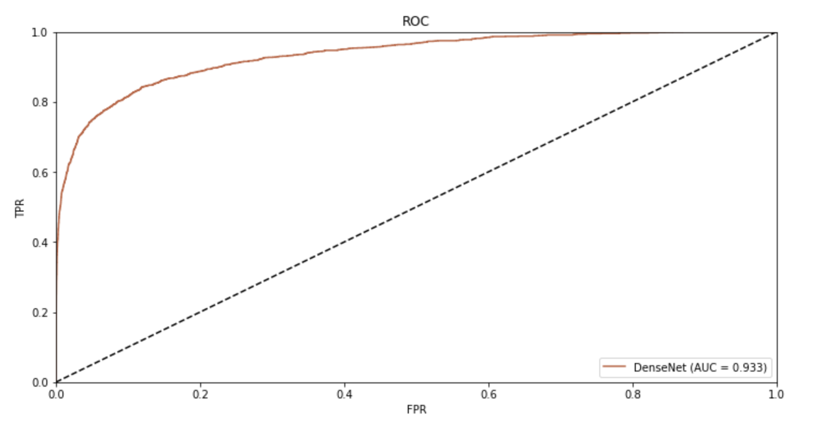
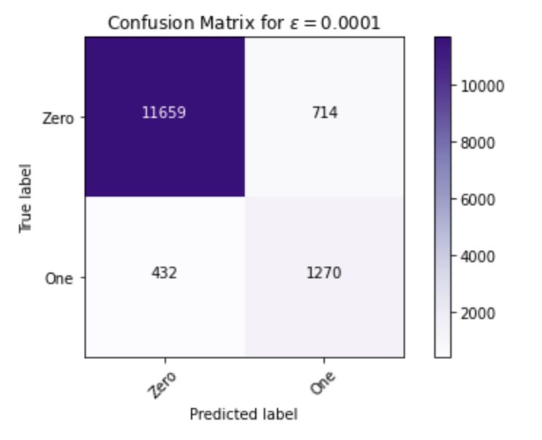
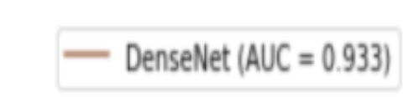
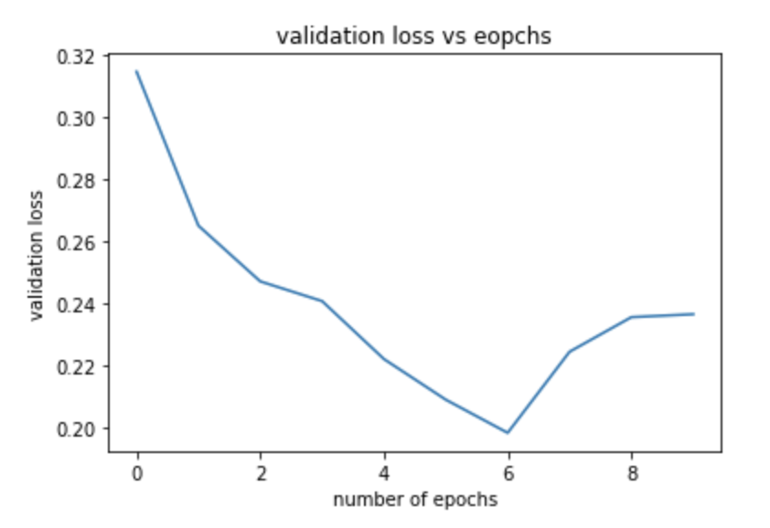
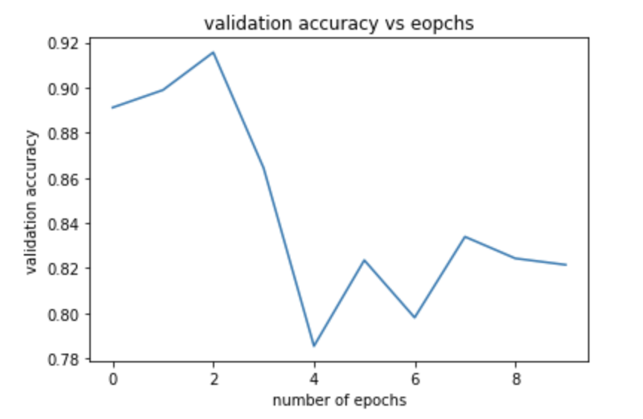
Best Performance-DenseNet169

Slide 12
Timeline
Early Feb:
Nail down the topic and fetch data
Mid March to Mid April: Applying GAN and running baseline model
End April to now: Aggregating results and thoughts on future work...
Mid Feb to Mid March:
Data cleaning and splitting data into train, validation, and test
Mid April to End April:
Applying window function and running advanced models

Slide 13

Thanks

